Slide 1
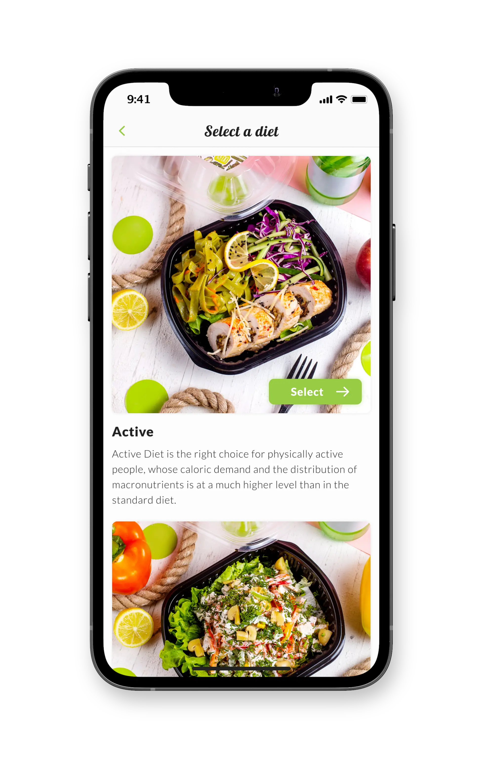

Nutri Byte
Vandita Verma

Slide 2
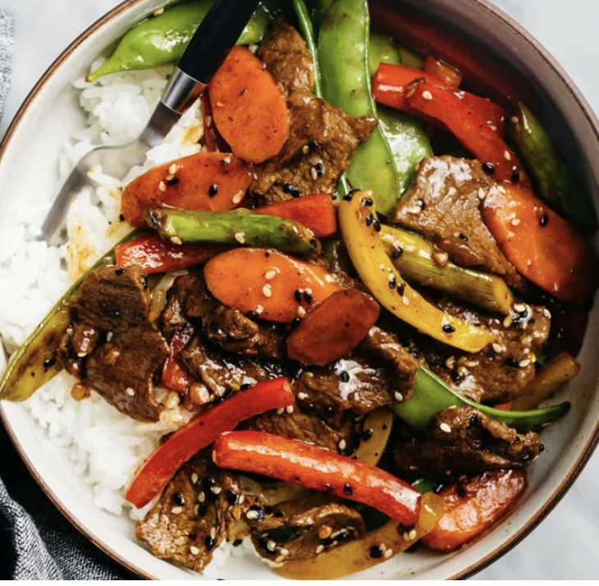
Agenda
1
Value Proposition and Opportunity
2
Competition, Differentiation, GTM Plan
3
Finance, Risks and Returns
4
Ask and Next Steps

Slide 3
Value Proposition and Opportunity
Strategic Gaps
Nutrition meal apps lack AI-powered recommendations.
Fewer engagements impact customer retention.
Single-Serving meal plan restrictions.
Community-Centric Offerings.
$310 billion
Globally
$500 million
USA
$40 million
NYC
Value Proposition
User-friendly solutions that offer flexibility in meal ordering.
Customized meal options tailored to the user's preferred ingredients.
Provide nutritional dictionary via AI Image Scanning Technology.
On-demand nutritionist consultations for customer engagements.

Slide 4
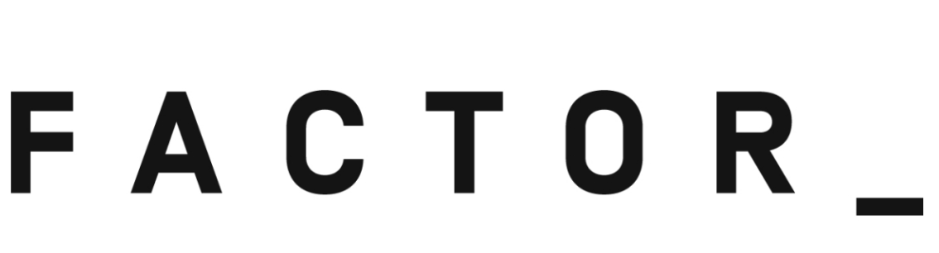
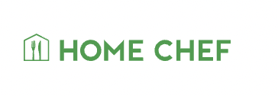
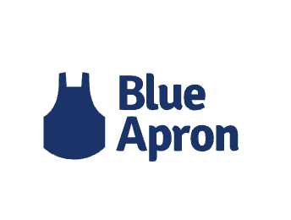

Competition, Differentiation, and GTM Plan
Food availability ( Breakfast, Lunch, and Dinner)
Customer Support
Meal recommendation
Traditional Meal Plans/ Meal Options
GTM Plan for B2C Market
Phased Approach Model
Marketing
Social Media
Emailing
TV Commercials
Subscription Plans
Freemium (3 meals)
Premium (20 meals)
Premium+ (Capped Meals)

Slide 5
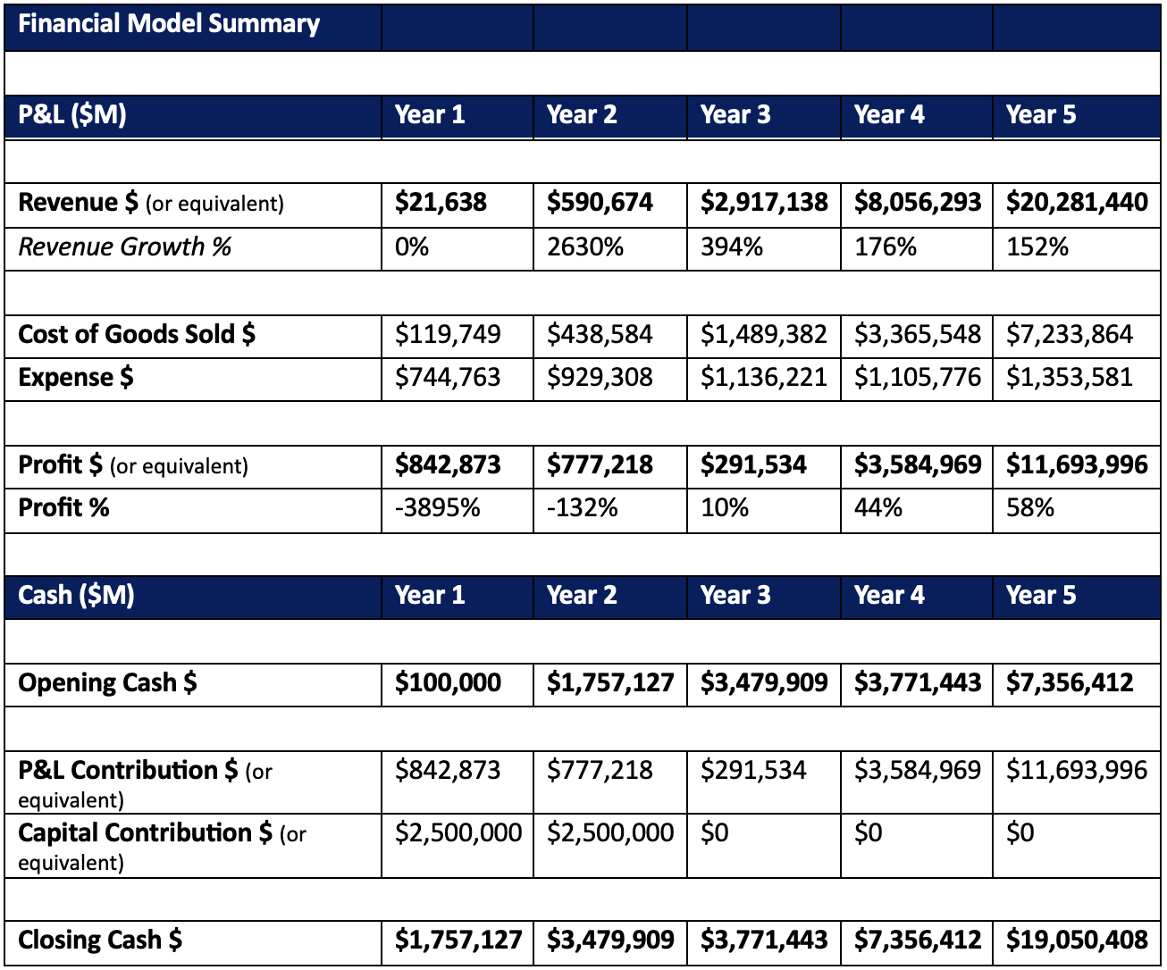
Finance, Risks and Returns
P&L Cash
Exponential Growth Rate in Revenue by Year 5.
Profit growth is 58% in Year 5.
Strong Cash Flow: Increasing cash balance & closing at $19,050,408.
Success Factors
Maintaining customer loyalty in a fiercely competitive market.
Attracting and retaining skilled employees to build a talented workforce.
Creating a nutritional algorithm aligned with our unique value propositions.
Implementing a compelling marketing strategy to enhance customer acquisition.
Risks
Opportunity to penetrate the market.
Ensuring data security.
Adhering to regulatory requirements.
Sensitivity Analysis
Plan B
Act II

Slide 6
Ask
Next Steps
Year 1 Utilization
Developing the application and implementing advanced AI technology.
Formulating a product-market fit strategy to reach a wider audience.
Expanding marketing efforts to raise brand awareness and attract a substantial user base.
Year 2 Utilization
Deploying experienced Chefs and Nutritionists to ensure meal quality and nutritional balance.
Engaging in continuous research and development to drive innovation and enhance our offerings.
Investment Required: $ 5 million
Allocation -
Year 1 Utilization: $ 2.5 million approx.
Year 2 Utilization: $ 2.5 million approx.

Slide 7
Appendix

Slide 8
Value Proposition Details
Market Details
Competition Details
Differentiation Detail
Product Detail
Go-to-Market Detail
Financial Model Detail
Financial Model Market Analysis
Returns(NPV/IRR)
Sensitivity Analysis: Part 1
Sensitivity Analysis: Part 2
Success Factors & Risks Details
Ask for Details
Next Steps Detail
15. Team Capabilities
16. Organization Charts
17. Culture and Values
18. OKRs
19. Key Metrics
20. Performance Oversight & Management
21. Exit Landscape
22. Act II
23. Plan B
24. Ethical and Legal Compliance
25. Business Details (Number of Meals &
Customers)

Slide 9
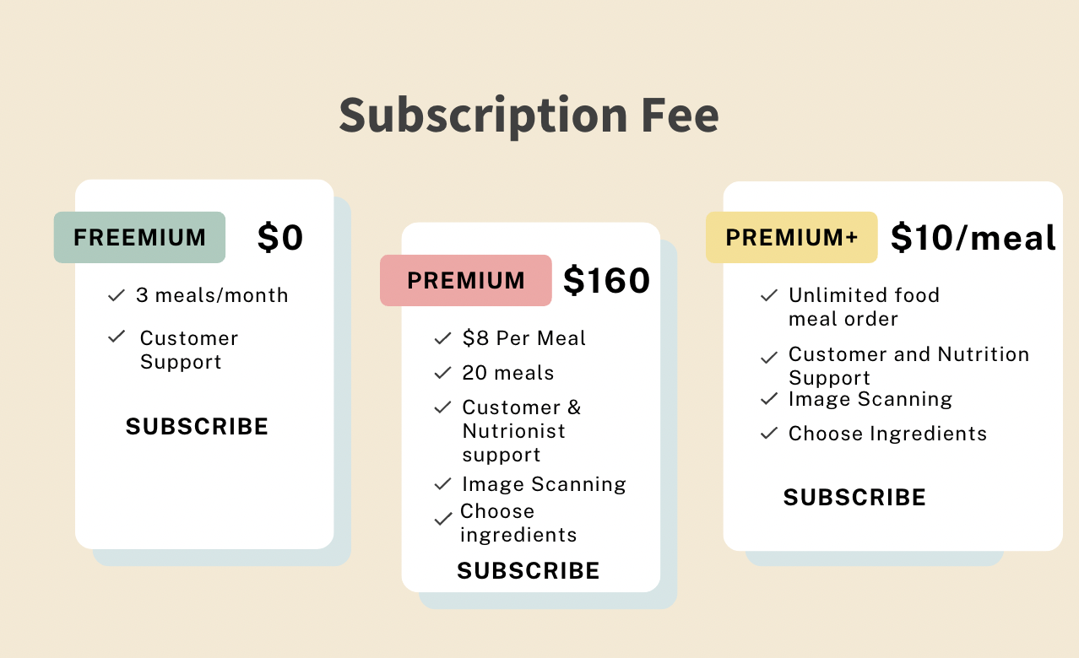
Value Proposition Detail
User-Friendly Solutions: Premium+ Plan
Enjoy the convenience of capped meal orders.
Perfect for families, group gatherings, and friends.
Flexible and inclusive meal planning for everyone.
Personalized Meal Selection: Tailored to Your Tastes
Enjoy a personalized meal selection.
Based on your preferred ingredients, include more Veg options.
AI Image Scanning Technology: Providing Nutritional Information
Understanding of nutritional impacts through image scanning.
Personalized meal assistance from nutritionists.
On-Demand Nutritionist Consultations
Expert guidance on choosing the right ingredients based on your dietary preferences and health goals.

Slide 10
Market Detail (description of The Game)
Size: Nutrition App Market
TAM - $310 billion (Globally)
SAM- $500 million ( USA )
SOM –
Revenue from the Indian Community (NYC)= Revenue from Nutrition Industry (NYC) *
% of Indians (NYC)
$40 million
Growth and Win in Marketplace:
Fostering community through user reviews and pictures on our application.
Engage NYC customers with a Freemium takeaway option offering three meals
Utilizing AI for recommendations and image-scanning.

Slide 11
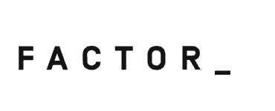
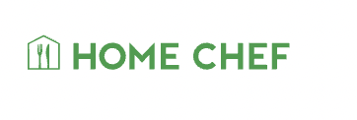
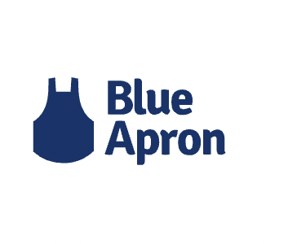
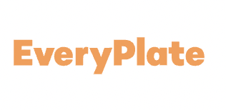
Competition Detail
Competitive Landscape
Customization is a prominent feature across all competitors, enabling customers to personalize their meal plans according to their preferences and dietary restrictions.
Our nutritionist consultations enable customers to incorporate their own ingredients, ensuring a personalized meal plan with optimal nutritional balance. Through collaborative efforts, we tailor the plan to meet each customer's specific needs.
Leveraging advanced customer data analysis, NutriByte curates meal recommendations tailored to each individual's unique needs and preferences.
Convenience is another common aspect, with all competitors prioritizing easy and hassle-free meal preparation for their customers.

Slide 12
Differentiation Detail (matrix analysis useful)
Food availability ( Breakfast, Lunch, and Dinner) | It does not provide any breakfast options | It offers a wide range of choices but limits certain meals to specific audiences | NutriByte provides a comprehensive range of meal options, including family-friendly solutions.
Customer Support | Provides supports | Factor offers limited customer support, while Blue Apron faces challenges with customer retention. | NutriByte aims to build a customer community to foster engagement and interaction among its users
Meal Recommendations | It does not provide any meal recommendations | Competitors come with new meals each week to understand customer needs. | NutriByte collects the data and recommends meals based on their choices.
Traditional Meal Plans/ Meal Options | Limited selection of vegan recipes. | Factor lacks traditional veg plans; they avoid certain ingredients to prevent them from overpowering the dish's flavor profile | NutriByte provides fully customizable options, empowering customers to choose their ingredients while receiving personalized guidance from nutritionists.

Slide 13
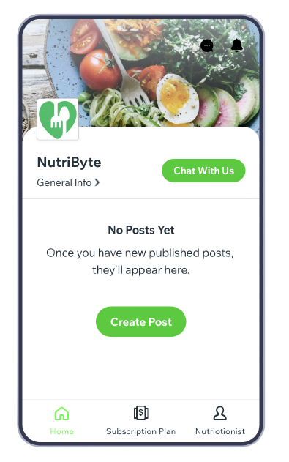
Product Detail
Nutri Byte’s Application
Nutri Byte’s Meal Plans

Slide 14

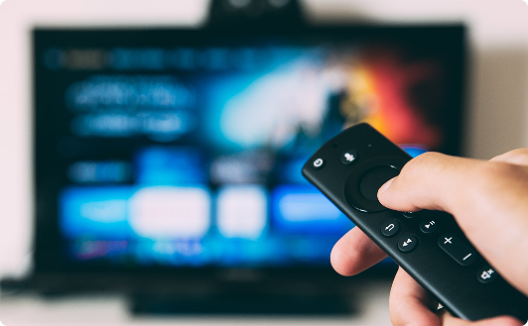

Go-to-Market Detail
Social Media and Emailing
TV Commercials
Subscription Plans
Cultural-Relevant Content
Captivating Storytelling
Freemium (3 meals)
Targeted Advertising
Showcasing Product Benefits
Premium (20 meals)
Community Building
Call-to-Action (CTA)
Premium+ (Capped Meal Orders )
Testimonials and User Stories
Impactful Visuals and Music

Slide 15
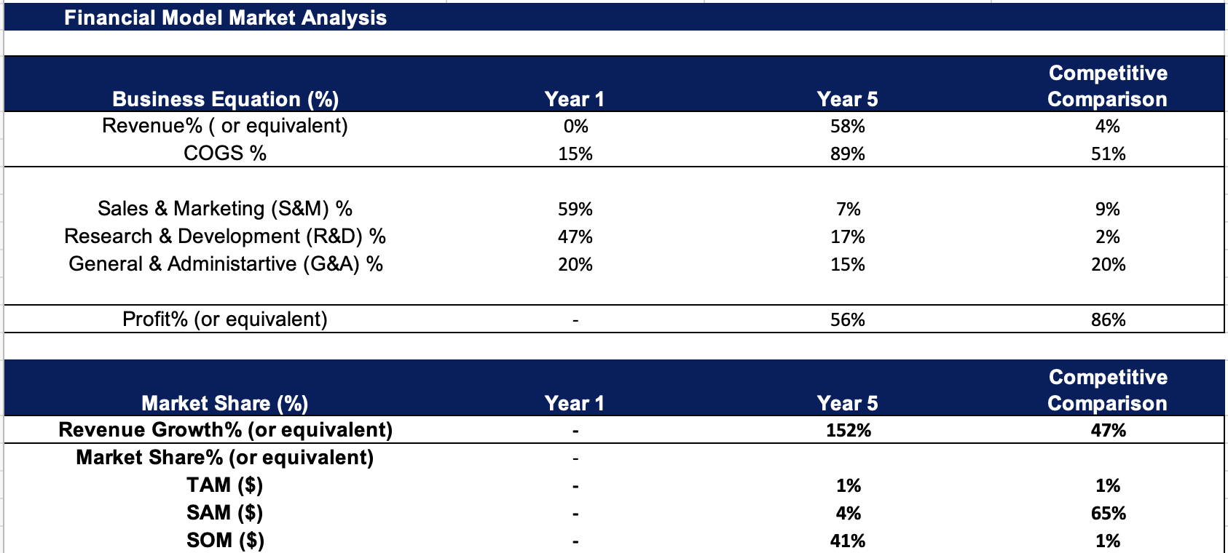
Financial Model Market Analysis
Business Equation
Nutri Byte: Competition
TAM Comparison- 310 billion: 14 billion
SAM Comparison- 500 million: 9 billion
SOM Comparison- 40 million: 20 million
Revenue Growth
Nutri Byte's revenue varies with market size, surpassing the competition with a remarkable 58% growth compared to their 4% during 2019-2020
Nutri Byte's Market Share hinges on the Indian community in NYC, while competitors target a broader market range, resulting in varying Shares of the Market (SOM) for each.
IRR/NPV

Slide 16
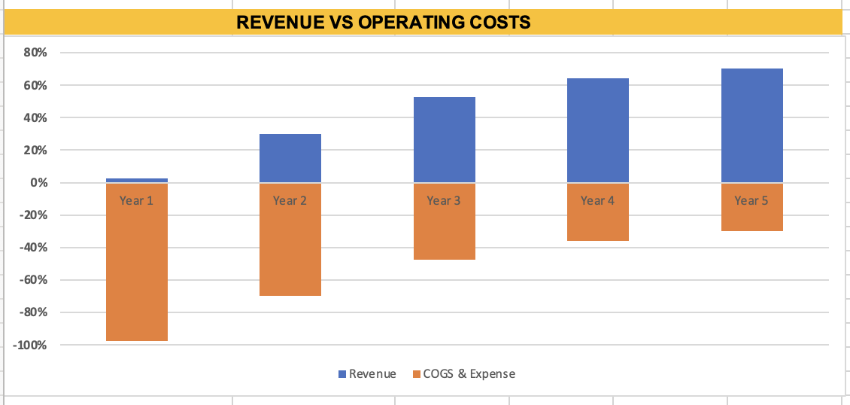
Financial Model Detail
Capital contribution of $5 million leads to a projected 58% profit by Year 5.
By Year 3, NutriByte starts generating revenue and achieves a 10% profit, marking a significant profit curve point.
Revenue growth sees a consistent upward trend over time.

Slide 17
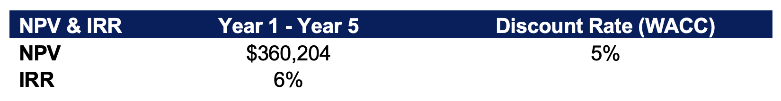
Returns (NPV / IRR)
The WACC is derived from the discount rates of three competitors, resulting in an average WACC of 5%, considering the nutrition market size. The positive NPV indicates profitability, although thriving in a highly competitive market necessitates strategic investments.

Slide 18
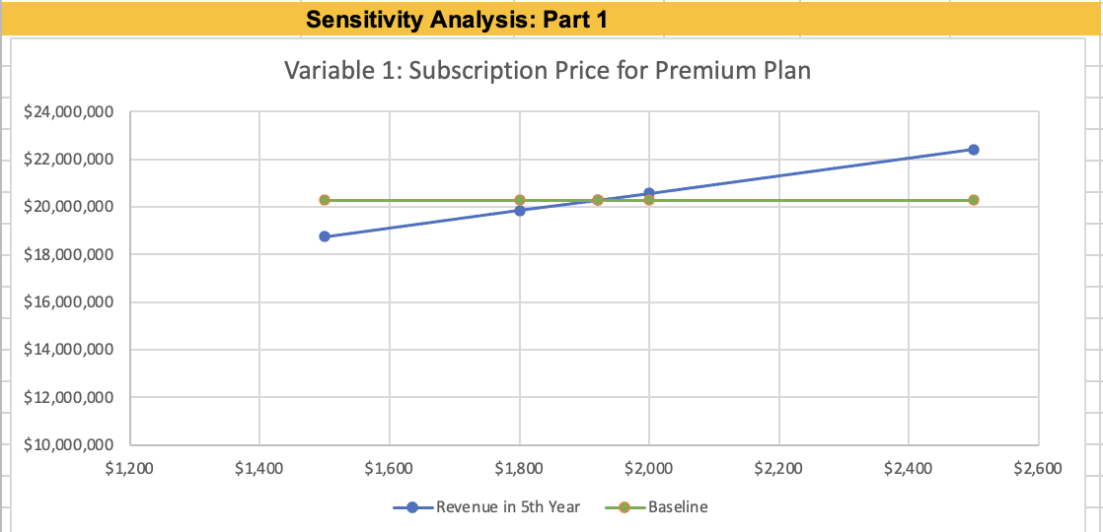
Sensitivity Analysis: Subscription Price Change
Price: Revenue | Price: Revenue | Baseline : Revenue | Price: Revenue | Price: Revenue
$1500 : $18 million | $1800 | $1920 :$20 million | $2000 | $2500: $22million
By Scaling up and Scaling down the baseline we can see the change happening in Revenue 5th Year

Slide 19
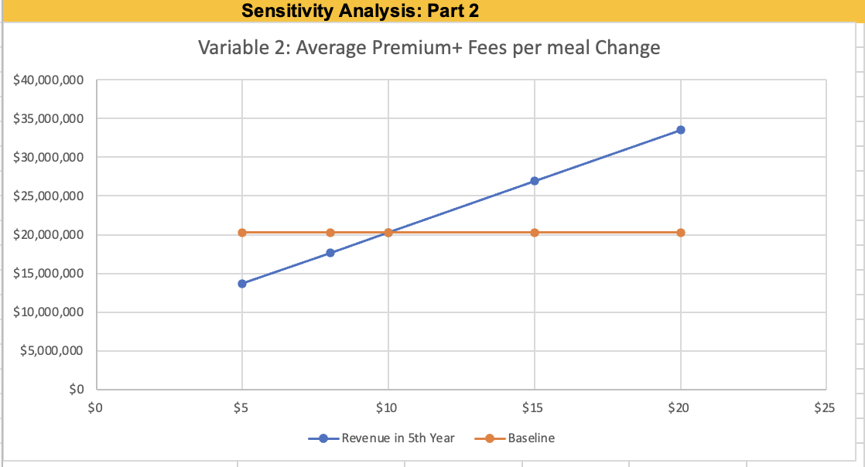
Sensitivity Analysis: Part 2 -
Average Premium+ Price per meal
Price: Revenue |  | Baseline |  | Price: Revenue
$5: $13million | $8 | $10 | $15 | $20 : $33million
By Scaling up and Scaling down the baseline we can see the change happening in Revenue 5th Year

Slide 20
Success Factors & Risks Detail
Success Factors
Customer Loyalty: Maintain loyalty through high-quality products, exceptional customer support, and personalized experiences.
Skilled Workforce: Attract and retain skilled employees with a strong employer brand, competitive compensation, and growth opportunities.
Nutritional Algorithm: Develop a unique nutritional algorithm for personalized meal plans aligned with our value propositions.
Compelling Marketing: Implement an effective marketing strategy using data analytics and various channels to acquire new customers.
Risks
Market Penetration: Entering new markets requires thorough research to understand demand and competition.
Data Security: Protect customer information through robust cybersecurity measures.
Regulatory Compliance: Adhere to food industry regulations and quality standards.
Sensitivity Analysis

Slide 21
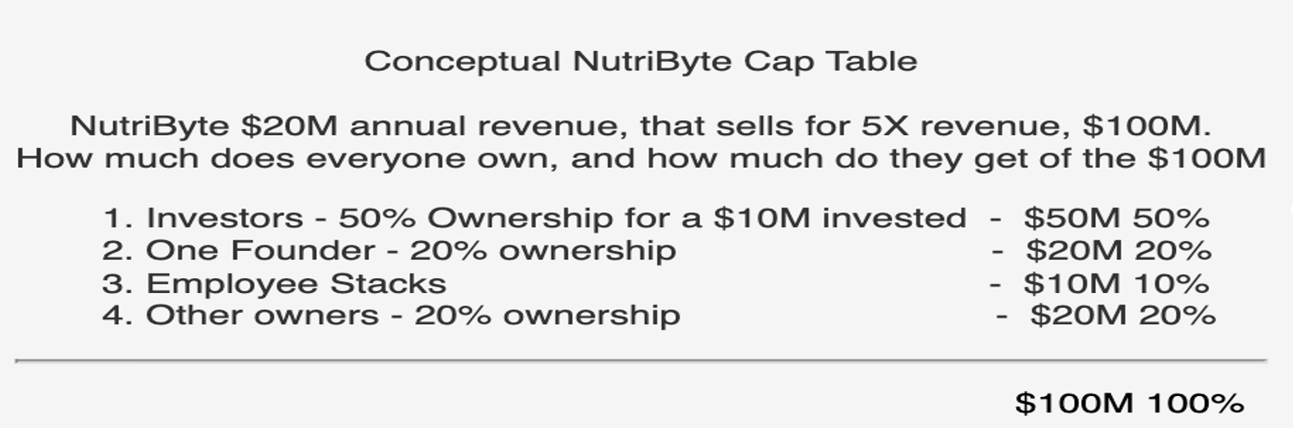
Ask for Detail (legal, deal & cap table)
Deal Terms
Capital Investment
Limited Liability Protection
Profit Distribution
Management and Control
Vesting and Lock-up Periods
Use of Funds
Aligned Mission and Values
Legal Structure
Legal Structure of the Organization: NutriByte LLC
Limited Liability
Pass-Through Taxation
Operational Flexibility

Slide 22
Next Steps Detail
Year 1: Building Foundations
Year 2: Expanding Reach
Year 3: Consolidating Growth
The initial focus will be on achieving Product Market Fit by investing in R&D for product development. In the latter half, the strategy shifts to extensive marketing efforts and product and app testing.
The primary objective is to reach out to the Indian community in NYC through culturally relevant marketing. Providing multilingual support and collecting feedback will improve the user experience and build brand loyalty.
In Year 3, the focus is on consolidating growth, optimizing operations, and retaining customers. Increase marketing efforts, refine the product, and monitor market trends for sustained success.
Year 4: Scaling & Enhancing
Effectiveness
Year 5: Sustainable Growth &
Innovation
Year 4 focuses on closely monitoring KPIs and using data-driven decisions to refine marketing, products, and operations. The goal is to balance growth and optimization for a scalable business model that meets rising demand while ensuring customer satisfaction.
Sustainable growth, innovation, customer retention, and vigilant expense management will secure our market leadership and bright future.

Slide 23






Team Capabilities
Engineering
Marketing Management
Business Analyst
Design, develop, and maintain web-connected software with a high level of quality.
Base the decisions on customer behavior and needs strategically and with foresight.
Develop and execute business strategies for sustainable growth.
Customer Support
Chefs
Nutritionists
Empathetic Customer Communication & Efficient Problem-Solving.
The ability to create delicious and nutritious menus tailored to dietary needs and preferences.
Designing personalized, balanced meal plans for individual dietary requirements

Slide 24
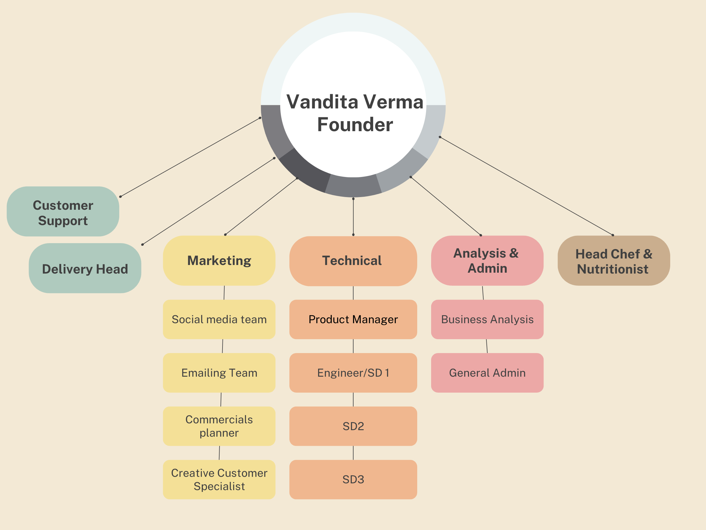
Organization Chart

Slide 25
Culture and Values
Teamwork & Collaboration
Convenience
1
2
3
4
Customer Focus
Innovation

Slide 26
OKRs (strategic – board-level)
OKR 1
OKR 2
OKR 3
Provide an Exceptional Nutrition and Wellness Platform
Enhance Customer Experience and Engagement
Expand Market Reach
OKR 4
OKR 5
Foster a Culture of Innovation and Collaboration
Diversify Product Offerings

Slide 27
Key Metrics
OKR 1: Provide an Exceptional Nutrition and Wellness Platform
Key Metrics: Design, develop, and maintain a user-friendly and web-connected software platform that offers personalized nutrition solutions to customers.
OKR2: Enhance Customer Experience and Engagement
Key Metrics: Achieve a customer satisfaction rating of 90% or higher based on feedback surveys.
OKR3: Expand Market Reach
Key Metrics: Enter new places within NYC to capture a substantial Indian community presence
OKR4: Diversify Product Offerings
Key Metrics: Collaborate with nutritionists, chefs, and suppliers to develop a wide range of meal options that cater to various dietary preferences, including vegan, vegetarian, and gluten-free.
OKR 5: Foster a Culture of Innovation and Collaboration
Key Metrics: Implement innovative technology features to enhance user experience.

Slide 28
Performance Oversight & Management
Oversight
Nutri Byte's governance plan focuses on customer-centric culture, collaboration, and innovation.
The decision-making process categorizes decisions into strategic, operational, marketing, and product-related areas.
Decision-making authorities are designated based on roles, expertise, and responsibilities.
Management:
Key decision roles will be handled by various employees in the organization:
Nutritionists & Chefs.
Marketing.
Product Analysts
Founders
Customer support
Technical team.
Marketing Team.

Slide 29
Exit Landscape
Exit Option 1: Merger and Acquisition (M&A)
Explore M&A Opportunities: Identify strategic partners in the health and nutrition industry for potential mergers or acquisition.
M&A Process Steps: Conduct research, due diligence, negotiations, integration planning, and secure regulatory approval.
Successful Transition: Selected partner acquires majority stake in NutriByte.
Exit Option 2: Initial Public Offering (IPO)
Going Public: opt for IPO to raise capital and access public markets.
IPO Process: Prepare for IPO, file registration statement, conduct roadshow, and investor presentations.
Listing Day: NutriByte shares are listed and traded on the stock exchange.
Continued Growth: Utilize IPO funds to drive growth and strategic initiatives.

Slide 30
Act II
Expansion and Collaboration in the Wearables Industry
Strategic Focus: Partner with the wearables industry, including Nike and Adidas, to tap into the sports market.
Market Potential: United States is the largest consumer of activewear with an industry revenue of $126.1 billion in 2020, driven by young consumers investing in well-being.
Customer Impact: Targeting Gen Z and Millennials who prioritize fitness and well-being, leveraging customer reviews to drive market trends.
Technological Integration: Seamless integration of the NutriByte app with Nike's wearable devices, enabling real-time nutrition tracking and personalized meal recommendations.
Continuous Improvement: Invest in R&D for advanced algorithms, data analytics, and expand infrastructure to support growing operations.
Competitive Edge: Strengthen Nutri Byte's position as a leader in providing integrated nutrition and fitness solutions, catering to evolving customer needs through strategic collaborations and enhanced technology.

Slide 31
Plan B
Strategic Acquisition for Resilience
Plan B is Nutri Byte's contingency strategy, designed to tackle potential setbacks in a highly competitive market. It involves being open to the possibility of being acquired by a larger firm to ensure ongoing operations and access to vital resources. This proactive approach demonstrates adaptability and resilience, safeguarding the company's future growth and ability to thrive in a dynamic market environment

Slide 32
Ethical & Legal Compliance
Legal Compliance
NutriByte strictly adheres to all applicable laws, regulations, and industry standards, ensuring its operations are in full legal compliance.
NutriByte prioritizes adherence to food safety regulations to guarantee the safety and well-being of its customers.
NutriByte ensures the protection of user data, complying with data protection laws to safeguard user privacy.
Ethical Practices
NutriByte treats customers, and employees, with fairness, respect, and integrity.
Nutri Byte promotes transparency in communications to build trust with its stakeholders.
NutriByte prioritizes the protection of user data and privacy, ensuring confidentiality and security.

Slide 33
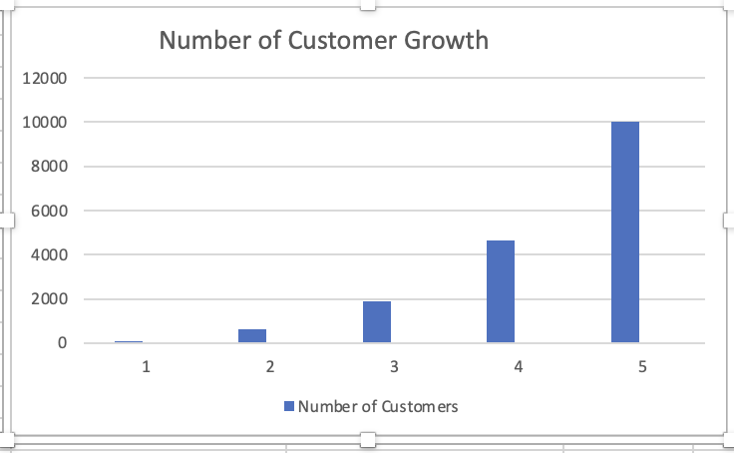
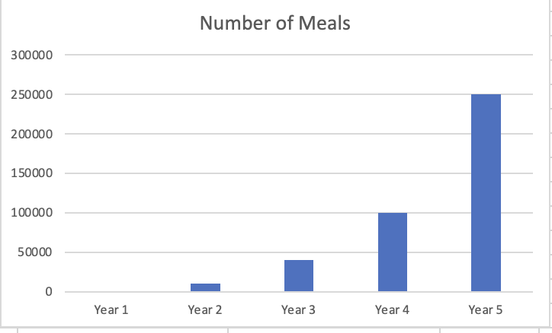
Business Details (Number of Meals & Customers)
Number of Meals are directly proportional to number of customers.
Number of Customers is seen growing exponentially.
Average number of Meals are calculated based on each subscription plan.
The Premium+ plan cap has a flexible meal cap between 5 to 30 per month.

